Slide 2
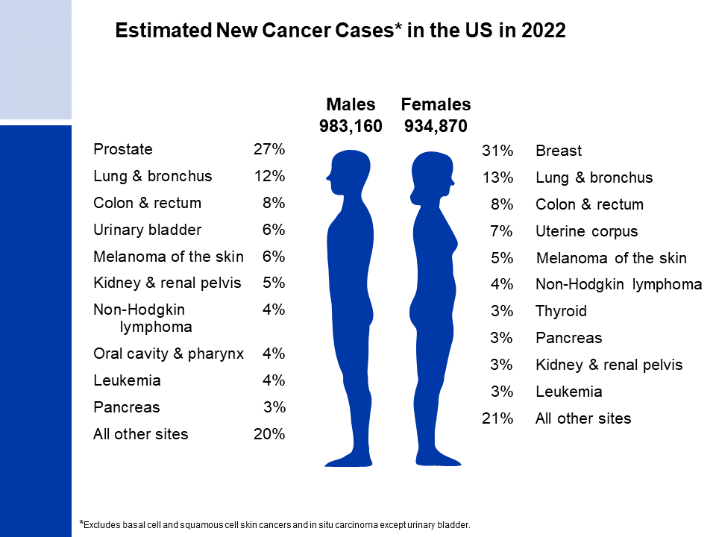
Notes:
It is estimated that more than 1.9 million new cases of cancer will be diagnosed in 2022. Prostate cancer is the most common cancer among males (27%), followed by lung (12%) and colorectal (8%) cancers. Among females, breast (31%), lung (13%), and colorectal (8%) cancers are the most common.
Rankings based on estimates should be interpreted with caution because they are model-based projections.

Slide 3
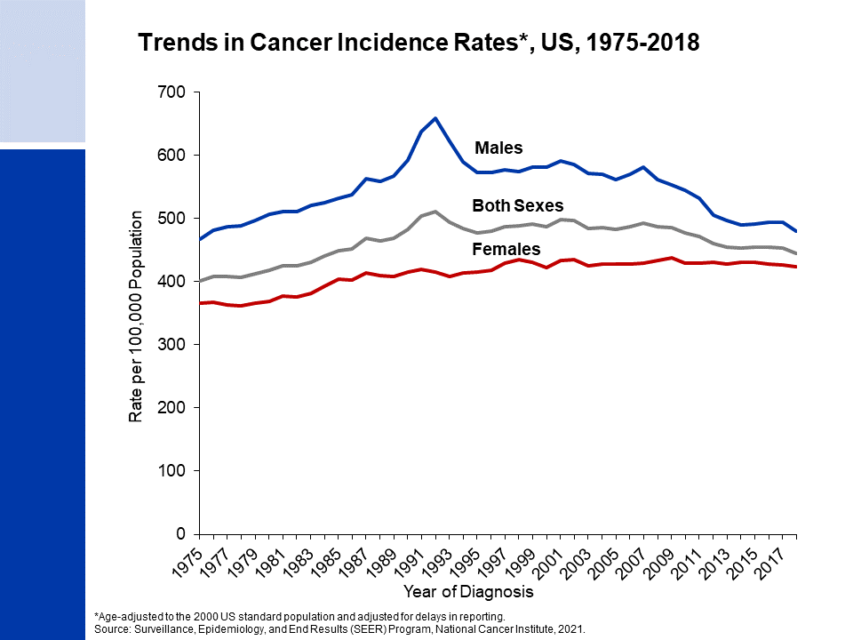
Notes:
This slide shows trends in cancer incidence rates for all sites combined by sex from 1975 to 2018. The reasons for higher cancer incidence among men than women are not well understood, but probably largely reflect more exposure to cancer-causing environmental and biologic factors, such as smoking and height. Overall cancer incidence in men generally decreased from the early 1990s until around 2013, then stabilized through 2018, whereas in women, the rate was fairly stable through the mid-2010s but has ticked up slightly (0.2% per year) in recent data years. Consequently, the incidence disparity between males and females has narrowed from a male-to-female incidence rate ratio of 1.39 in 1995 to 1.14 in 2018.
The 9 oldest SEER registries represent approximately 9% of the US population and are the source for historic (since 1975) population-based cancer incidence data.

Slide 4
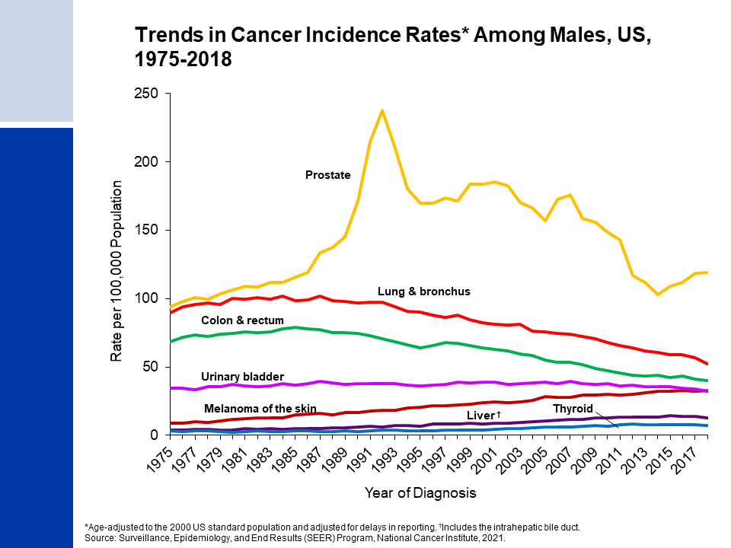
Notes:
Prostate cancer is the most commonly diagnosed cancer in men. Incidence trends over the past several decades largely reflect changes in the use of screening with the prostate-specific antigen (PSA) test. For example, incidence spiked during the early 1990s reflecting a surge in the detection of asymptomatic disease with the initial widespread rapid uptake of screening, then immediately dropped with the prevalence of first-time testing. The rapid drop in the incidence rate from 2007 to 2014 reflects decreased PSA testing following recommendations against routine screening for men aged 75 years and older in 2008 and all men in 2012 from the US Preventive Services Task Force. This downturn is likely related to an increase in the diagnosis of advanced prostate cancer since 2012 that is being watched closely.
Incidence rates have been declining for lung and colorectal cancers in males for more than two decades. Rates for melanoma and liver cancer incidence appear to have stabilized after decades of incline.

Slide 5
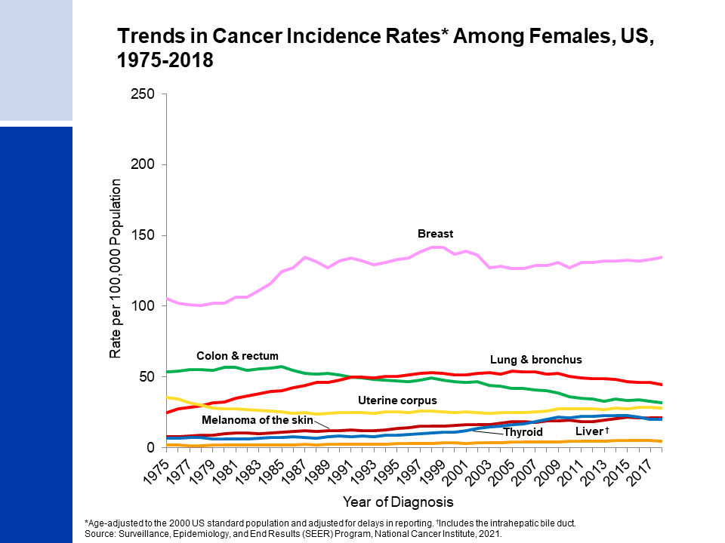
Notes:
Breast cancer is the most commonly diagnosed cancer in women. Breast cancer incidence rates have been increasing by about 0.5% per year since the mid-2000s, likely due to continued declines in fertility and increases in excess body weight. These factors may also have contributed to previous increases in uterine corpus cancer incidence, although rates appear to have stabilized in recent years. Lung cancer rates began to decline in the mid-2000’s after increasing since at least 1975. Differences in lung cancer trends between men and women reflect differences in smoking patterns, including later uptake and slower cessation among women. Colorectal cancer incidence rates have been generally declining since the mid-1980s. After decades of increase, thyroid cancer incidence rates declined during 2014-2018 due in part to the adoption of more conservative diagnostic criteria.

Slide 6
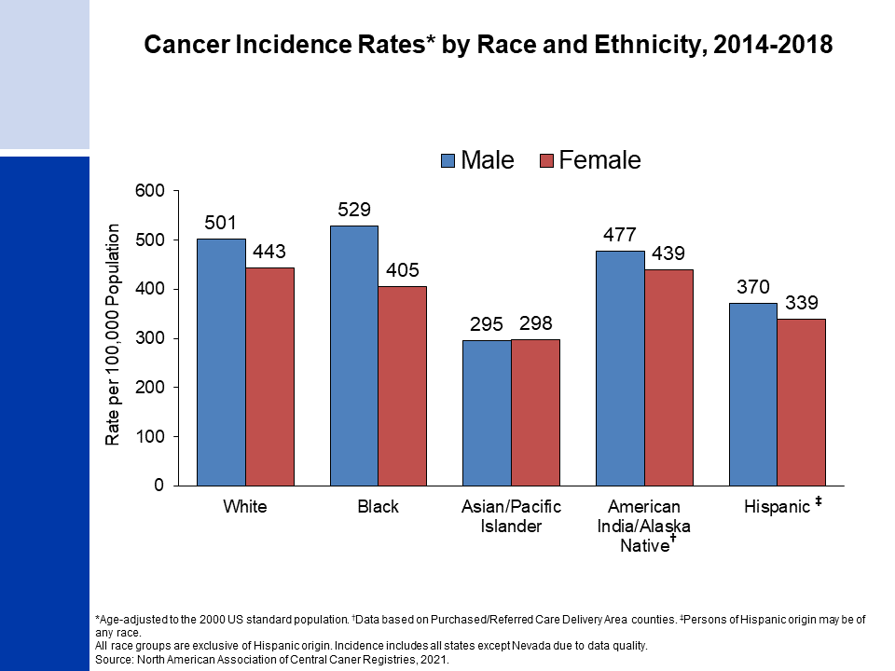
Notes:
Cancer incidence rates are higher in males than in females for each racial/ethnic population except among non-Hispanic Asian and Pacific Islander (API) persons. The highest incidence rates are for non-Hispanic Black people among males and non-Hispanic White people among females. Non-Hispanic API men and women have the lowest rates.
It is important to note that these are broadly defined groups within which cancer rates vary substantially. In addition, rates for populations other than White and Black may be underestimated due to incomplete information on race/ethnicity in medical records.

Slide 7
Notes:
The average lifetime risk of developing cancer in the US for men is 40.2%, or approximately 1 in 2. These figures are based on the average experience of the entire male population and vary for individuals because of lifestyle and other factors. For example, cancer risk among smokers is higher than average.

Slide 8
Notes:
The risk of a women developing cancer over her lifetime is 38.5% or one in three.

Slide 9
Notes:
There have been notable improvements in survival for most cancer types due to earlier detection and/or advances in treatment. For example, the five-year relative survival rate for leukemia has increased from 34% in the mid-1970s to 65% in the most recent time period because of improved treatment.

Slide 10
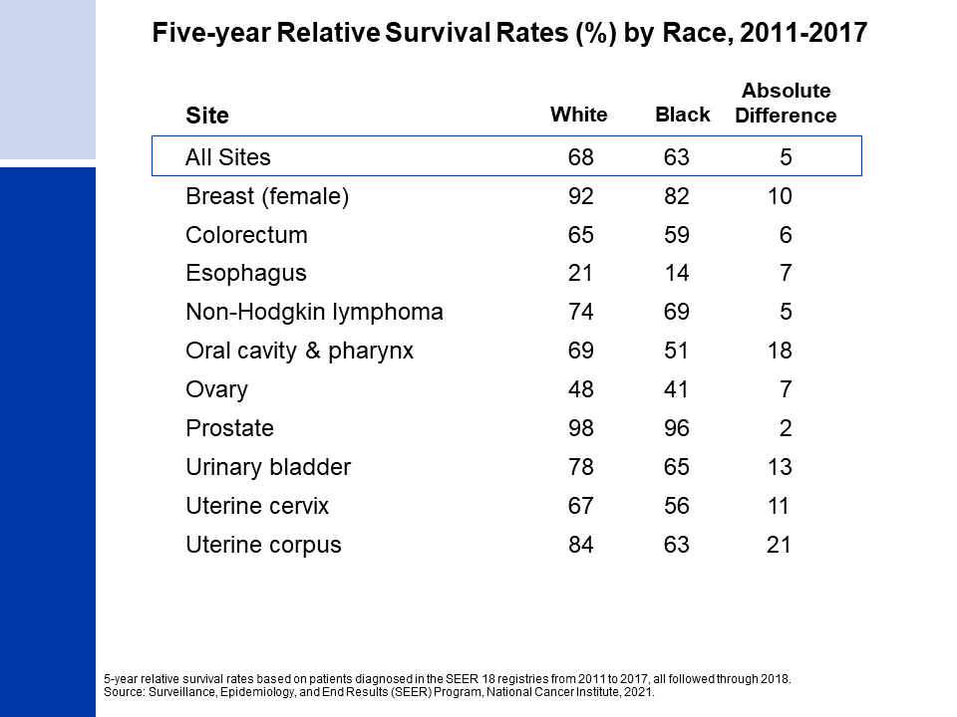
Notes:
While gains in survival have occurred for both White and Black cancer patients, Black people continue to have lower survival rates for most cancer types. The largest differences are for cancers of the uterine corpus and oral cavity & pharynx. Factors that contribute to these disparities include less access to high-quality health care and later stage diagnosis. Differences in tumor characteristics may also play a small role for some cancer types.

Slide 11
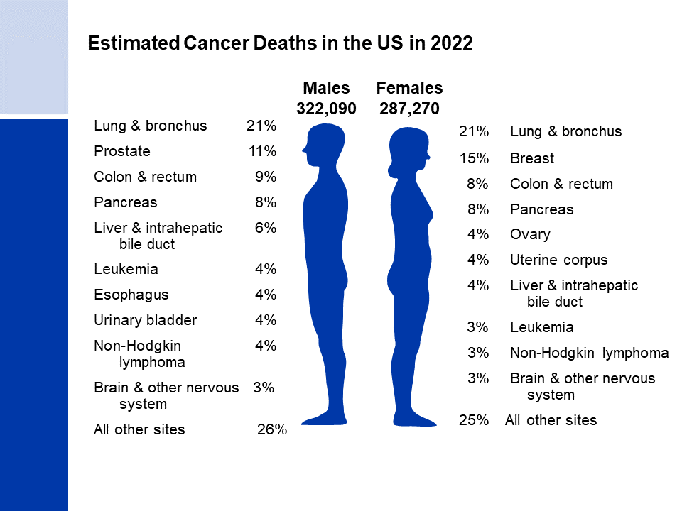
Notes:
Now we will turn our attention to cancer mortality. Lung cancer is by far the leading cause of cancer death among males (21%), followed by prostate (11%) and colorectal (9%) cancers. Among females, lung (21%), breast (15%), and colorectal (8%) cancers are the leading causes of cancer death. Lung cancer causes more than 350 deaths per day, more than breast, prostate, and pancreatic cancers combined, and two-and-a-half times more than colorectal cancer, the 2nd leading cause of cancer death.

Slide 12
Notes:
Cancer death rates have been declining in males and females since the early 1990s; from 1991 to 2019, the combined death rate dropped 32%.

Slide 13
Notes:
As a result of continuous declines in the cancer death rate since 1991, there were an estimated 3.5 million fewer cancer deaths through 2019 than would have been expected if the death rate had remained at its peak.

Slide 14
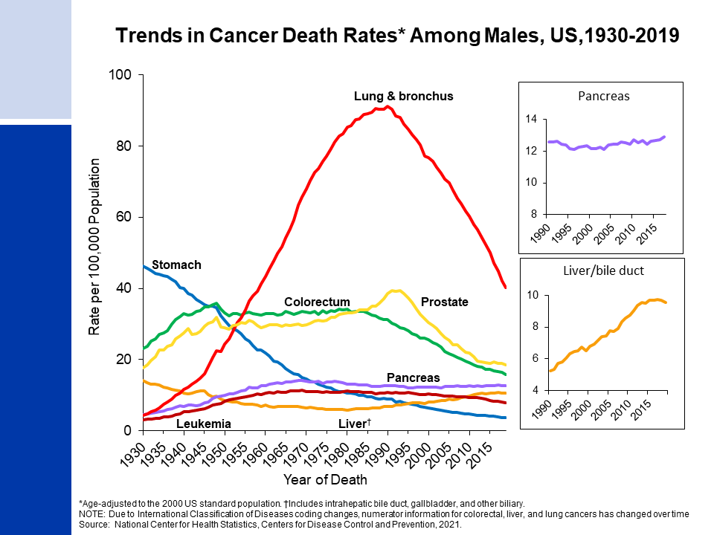
Notes:
Prior to 1990, most of the increase in the male cancer death rate was caused by the rapid increase in lung cancer due to the tobacco epidemic. However, lung cancer mortality in men has declined steeply since 1990, with the pace of decline nearly doubling over the past decade – from an annual decrease of 3.1% during 2005-2014 to 5.4% during 2014-2019. The death rate for stomach cancer, which was the leading cause of cancer death among males early in the 20th century, has decreased by more than 90% since 1930 because of declines in incidence as a result of refrigeration and lower intake of sodium-preserved foods. Death rates for colorectal cancer in men has dropped by 55% since 1978. The slowing decline in prostate cancer mortality likely reflects recent upticks in advanced-stage diagnoses associated with reductions in PSA testing. Liver cancer death rates increased rapidly for decades but have recently stabilized. Death rates for pancreatic cancer continue to increase slowly (by 0.3% annually since 2000).

Slide 15
Notes:
Lung cancer death rates in females didn’t begin declining until the early 2000s because of the delay in smoking uptake and cessation in women compared to men. Breast cancer death rates changed little between 1930 and 1989 but decreased by 42% from 1989 to 2019 due to earlier detection and improved treatment. As in males, stomach cancer mortality has decreased by more than 90% and liver cancer mortality has stabilized after years of increase. Uterine cancer death rates, which include corpus and cervix cancers combined because they were historically not separated, increased from the mid-1990s until around 2016 but appear to have stabilized in recent years.

Slide 16
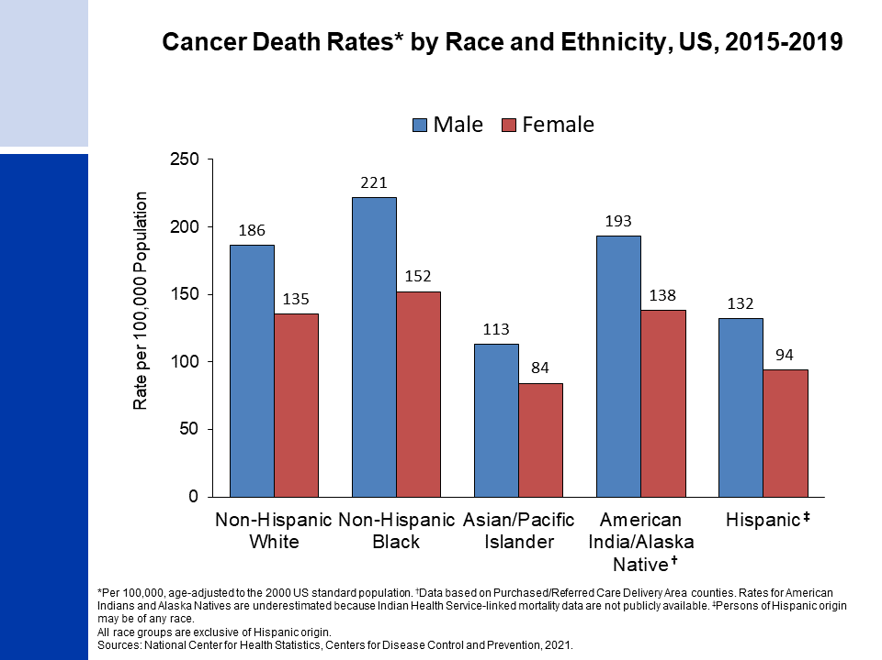
Notes:
Cancer death rates are higher among males than among females for every racial and ethnic group. Non-Hispanic Black (Black) males and females have the highest cancer mortality rates and non-Hispanic Asian/Pacific Islander individuals have the lowest, about half those of Black people.
It is important to note that there is a high level of misclassification in mortality data for indigenous persons and thus, rates presented for American Indians and Alaska Natives are underestimated by approximately 30% to 40%. See Arias et al. 2021 for more information (cdc.gov/nchs/data/nvsr/nvsr70/NVSR70-12.pdf). Misclassification also results in underestimated rates for other non-White and non-Black populations.

Slide 17
Notes:
The excess risk of cancer death in Black versus Whites individuals has dropped from 33% in 1993 to 14% in 2019 among men and women combined, with the gap larger in men than in women. Progress in reducing Black-White morality disparities is largely due to more rapid declines in the incidence (and thus mortality) of smoking-related cancers because of a steep drop in smoking initiation among Black teens from the 1970s to 1990s.

Slide 18
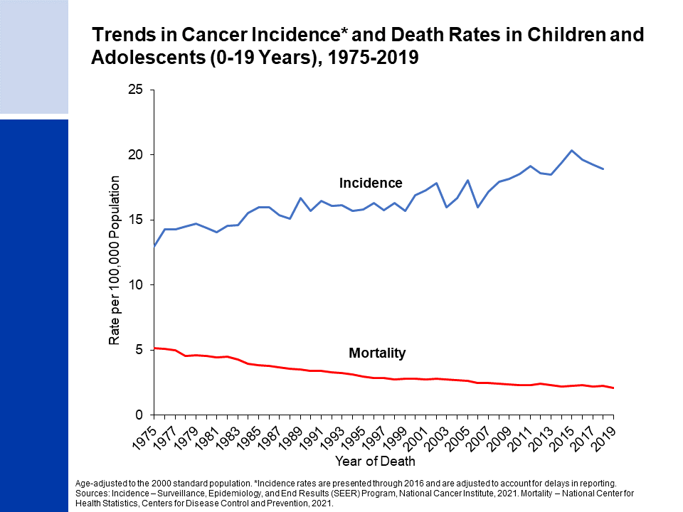
Notes:
The next series of slides present the burden of cancer among children and adolescents in the US. Cancer incidence and mortality trends in children (ages 0 to 14 years) and adolescents (ages 15 to 19 years) are very similar. Since 1975, cancer incidence rates have increased slightly by about 0.8% per year, whereas mortality rates have declined by 71% and 61% for children and adolescents, respectively, from 1970 through 2019. The large mortality reduction is largely because of improved treatment for leukemia, although progress has lagged somewhat for adolescents compared to children because of differences in tumor distribution and biology and less clinical trial enrollment, among other factors.

Slide 19
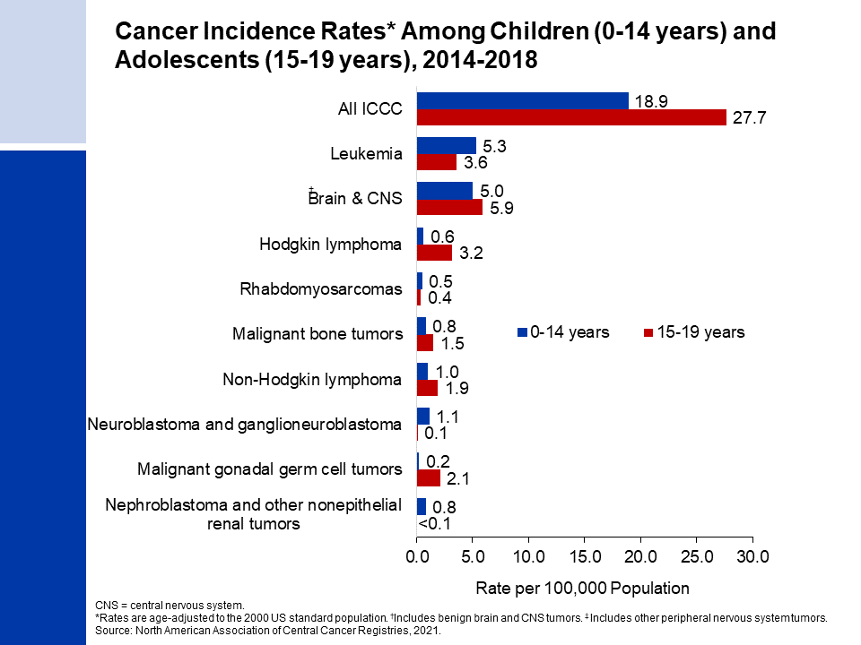
Notes:
This slide shows cancer incidence rates in children and adolescents by cancer type according to the International Classification of Childhood Cancers (ICCC). This system is more appropriate for children than adult tumor classification because it categorizes cancers based on a combination of tumor histology (microscopic structure) and location rather than location alone. Leukemia accounts for 28% of all cancers diagnosed in children, but just 13% of cancers diagnosed in adolescents.
Cancer registries were mandated by law to begin reporting benign and borderline malignant brain and central nervous system tumors on January 1, 2004. Reporting was expanded to include these cancers because benign tumors cause disruption to normal function similar to malignant tumors, often including moderate to severe long-term and late effects. Nearly one-third of all brain tumors diagnosed in children and more than one-half of those in adolescents are benign or borderline malignant.

Slide 20
Notes:
The top causes of cancer death in children and adolescents are brain and other nervous system tumors and leukemia. It is notable that leukemia has a higher death rate in adolescents than in children, despite having a lower incidence rate, because adolescents are less likely to survive the disease.

Slide 21
Notes:
For example, the current 5-year relative survival rate for leukemia is 87% for children but only 75% for adolescents. In contrast, survival for brain and other nervous system is slightly lower in children than in adolescents.

Slide 22
Notes:
The special section this year focuses on cancer in the American Indian and Alaska Native (AIAN) population. The AIAN population is extremely diverse, with 574 federally recognized tribes plus more than 200 tribes that remain unrecognized, encompassing many distinct customs, languages, and history. AIANs are especially vulnerable to cancer disparities because of historical and ongoing persecution and structural racism that has contributed to disproportionate poverty and lack of access to health care. AIAN people are more than twice as likely as White people to live in poverty, regardless of where they live.
This slide shows cancer incidence among AIANs compared to Whites by region, largely mirroring the pattern for lung cancer, which is highest in the Northern and Southern Plains and lowest in the Southwest.

